Slide 1
Machine Learning
Fitting a Simple Linear Regression model in Python
Siddharth Shrivastava

Slide 2
Plan of the session - Agenda
What we would do in the Python code today?
Import the libraries
Import the dataset
Create Matrix of features and dependent var vector
Handle missing data using mean values
Split the dataset in to training and test subsets
Fitting the simple linear regression model to training and test sets
Visualise the results on a graph
What is this session about?
Get started with programing to create a Simple Linear Regression model
Programing language - Python
IDE - Spyder (installed through Anaconda)
Demonstrate a working example of fitting a model to our dataset
At the end of this session, we should be able to create a Simple Linear Regression model in Python which could be used to predict the values of the dependent variable based on the values of the independent variable

Slide 3
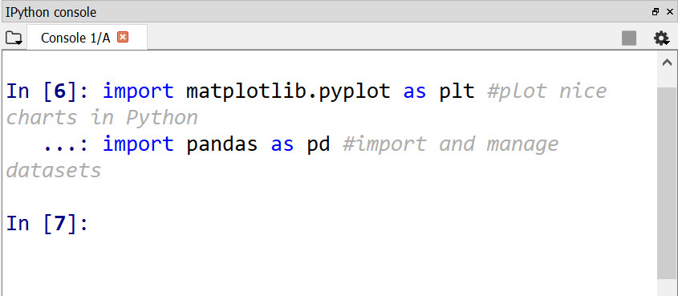
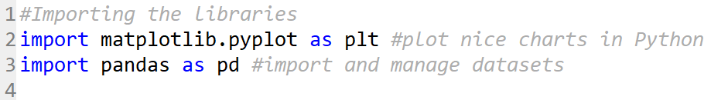
Step 1: Import the libraries
Pandas data analysis lib
Used to import and manage dataset
Matplotlib.pyplot
Used to plot graph for visualisation
sklearn.preprocessing.Imputer
sklearn.cross_validation.train_test_split
sklearn.linear_model.LinearRegression
Used to split arrays or matrices into random train and test subsets.
Used to model a linear relationship between a dependent variable and one or more independent variables.
Open source library
Provides high-performance and easy-to-use data analysis tools for Python
(Pandas.pydata.org, n.d.)
Various states are preserved across function calls, so the plotting functions are directed to the current axes (part of fig.)
(Matplotlib.org, n.d.)
The Imputer class provides basic strategies for handling the missing values – either using mean, median or most frequent value in the row or column.
(Scikit-learn.org, n.d.)
(Scikit-learn.org, n.d.)
Code snippet
Console

Slide 4
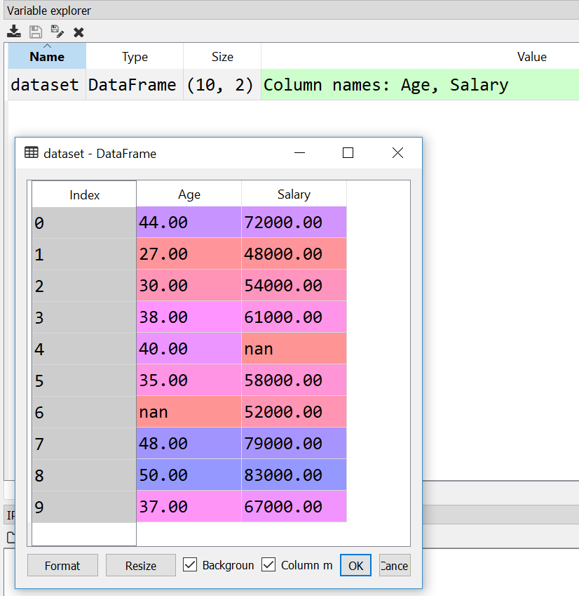
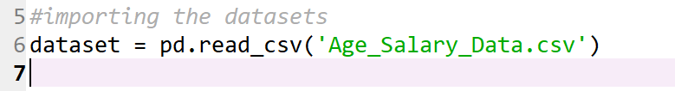
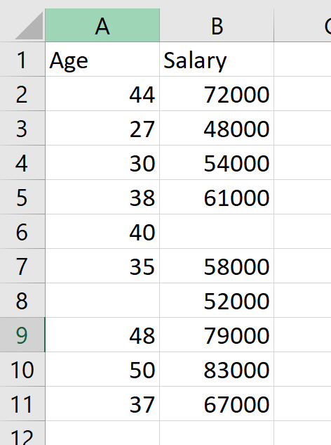
Step 2: Import the dataset
Code snippet
Alias for Pandas library
Data in CSV file
Imported dataset
Notice that the imported dataset has the value ‘nan’ in the cells that were blank in the datasheet. These cells would later be modified as part of handling the missing data.

Slide 5
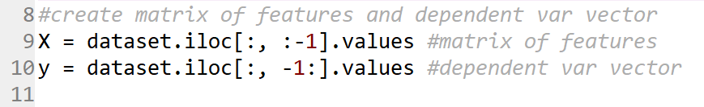
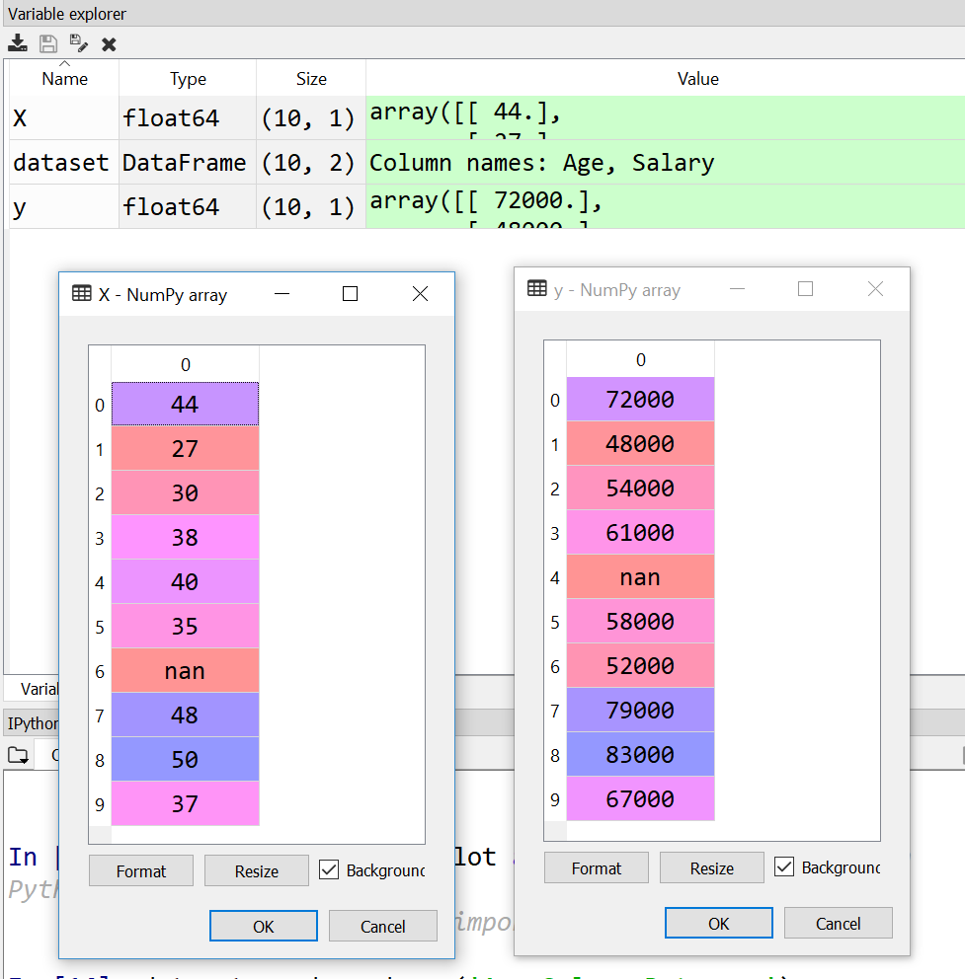
Step 3: Create matrix of features and dependent var vector
What is iloc?
0-based
When slicing, start bounds is included while the upper bound is excluded.
(Pandas.pydata.org, n.d.)
Matrix of features
Dependent variable vector
Purely integer based indexing method provided by Pandas.
A term used in Machine Learning to describe the list of columns in the dataset that contain independent variables. (Albert Cyberhulk, n.d.)
A term used in Machine Learning to define the list of dependent variables in the existing dataset. (Albert Cyberhulk, n.d.)
Variable explorer view

Slide 6
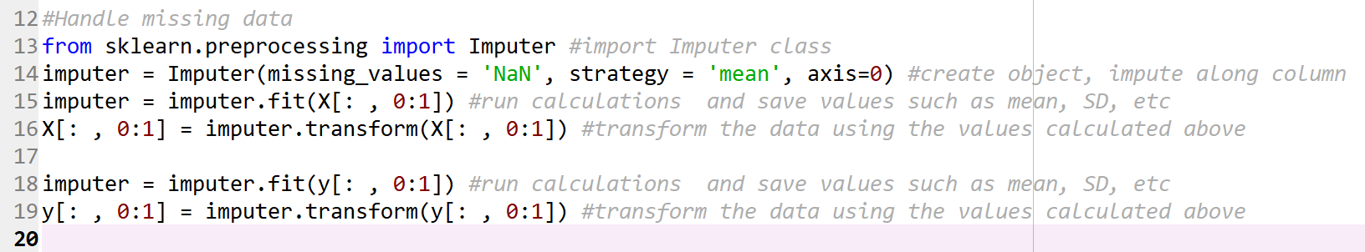
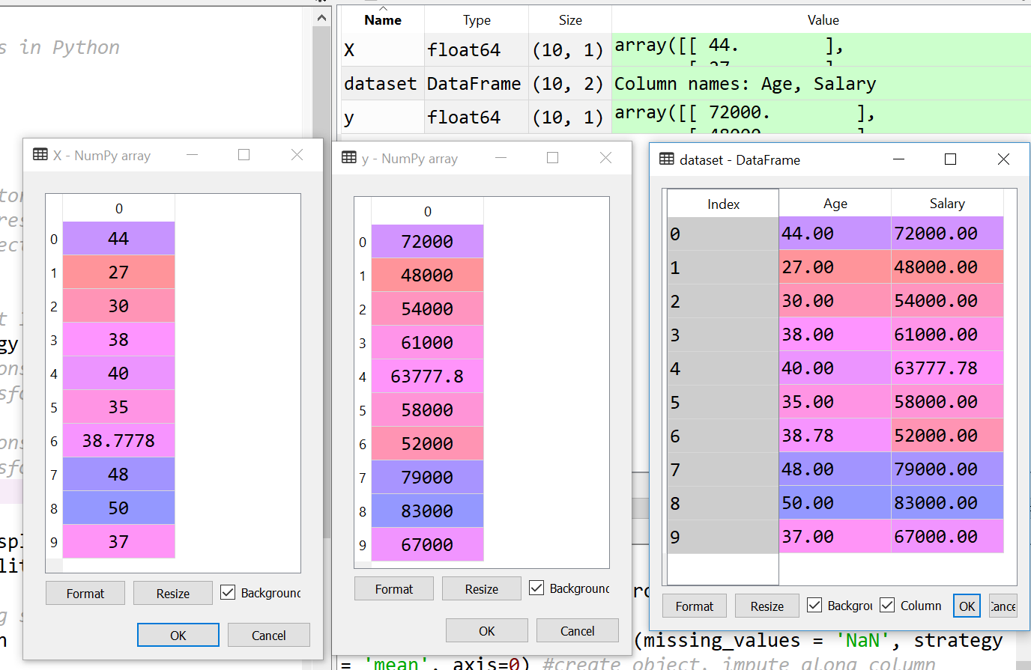
Step 4: Handle missing data
- axis = 0: Impute along the column
- axis = 1: Impute along the row
Imputation strategy
Strategy = “mean”: Replace the missing values using the mean along the axis.
Fit vs Transform
Fit: Finds the internal parameters of a model that will be used to transform data.
Why handle missing data?
Datasets with missing values are incompatible with scikit-learn estimators which assume that all values in an array are numerical, and that all have and hold meaning.
Strategy = “median”: Replace the missing values using the median along the axis.
Strategy = “most_frequent”: Replace the missing values using the most frequent value along the axis.
(Scikit-learn.org, n.d.)
Transform: Applies the parameters to the data.
You may fit a model to one set of data, and then transform it on a completely different set.
(scikit-learn, n.d.)
(Scikit-learn.org, n.d.)
Missing value is populated with the mean value

Slide 7
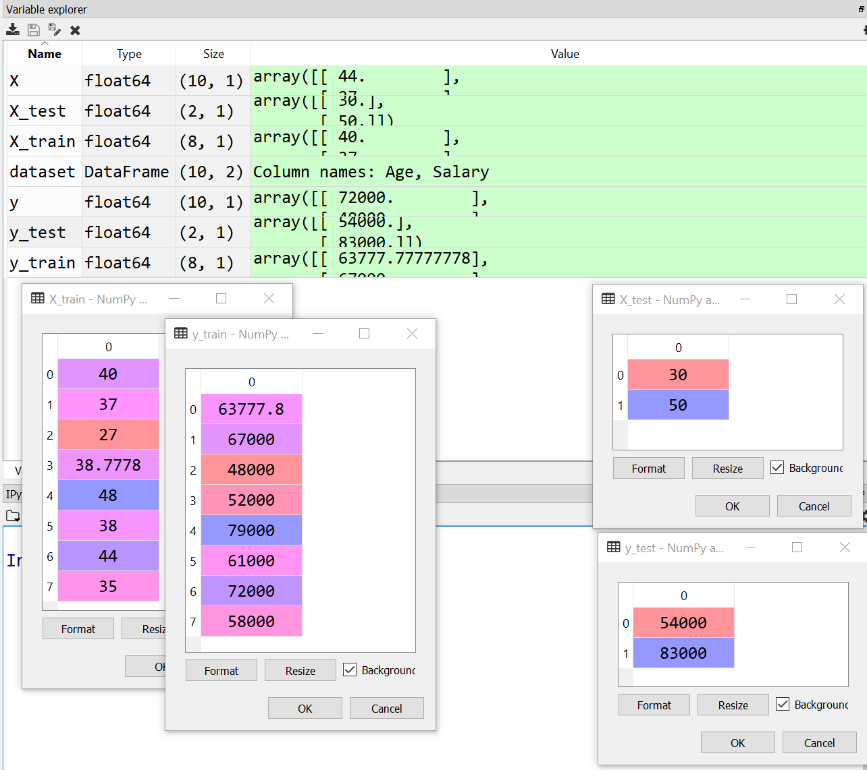
Step 5: Split the dataset in to training and test subsets
What is random_state
What is test_size (train_size)?
What are the subsets and their purpose?
Training subset: This subset contains the input values and the actual output values. The purpose is to train the model on the actual data.
The value of this parameter represents the proportion of the dataset to be included in the test split (train split).
A pseudo-random number generator state used for random sampling. (Scikit-learn.org, n.d.)
Test subset: This subset contains the input values only while the output values are predicted by the model.
The complete dataset is split in to subsets, one of which is used to train the model while the other is used to test it.
(Towards Data Science, n.d.), (set?, n.d.)
If float, the value should be between 0.0 and 1.0. If int then the value represents the absolute number of test samples (train samples). If None then the value is set to the complement of the train size (test size).
(Scikit-learn.org, n.d.)
Training sets with 8 records each
Test sets with 2 records each

Slide 8
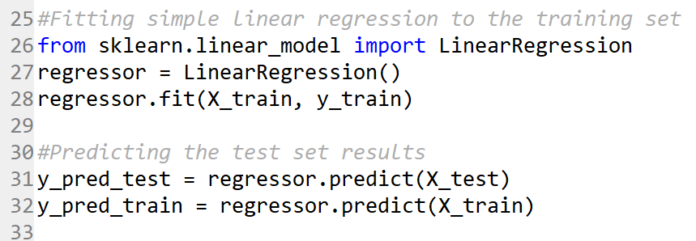
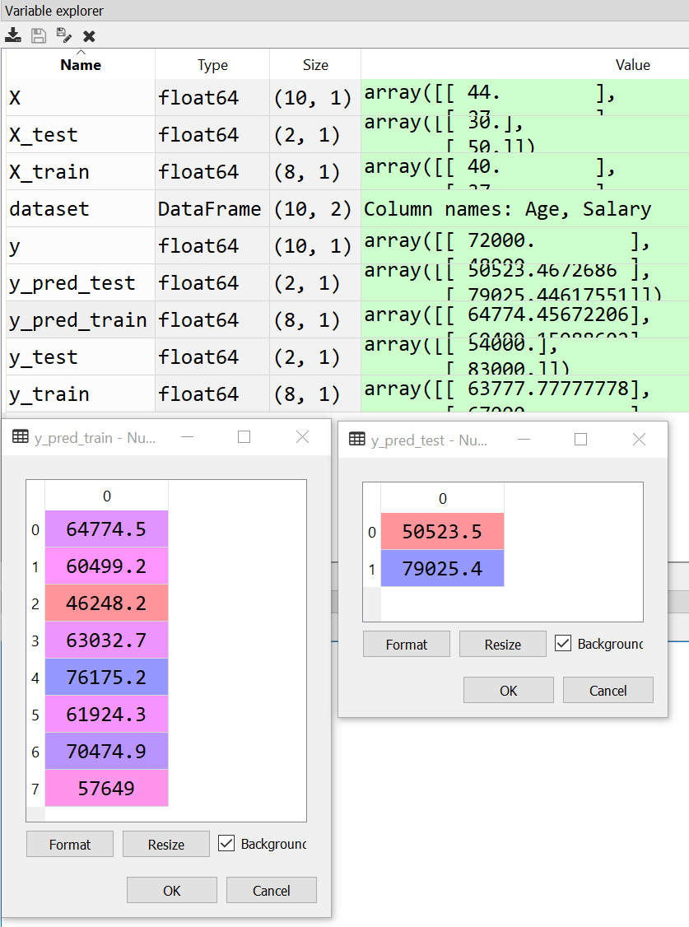
Step 6: Fitting the Simple Linear Regression model to data
We are using the model to predict the outcome.
What is linear regression?
In statistics, linear regression is a linear approach for modeling the relationship between a scalar dependent variable y and one or more independent variables denoted X. (En.wikipedia.org, n.d.)
The case of one independent variable is called simple linear regression. For more than one independent variable, the process is called multiple linear regression. (En.wikipedia.org, n.d.)
What is meant by fitting a model?
It is the process of constructing a curve, or mathematical function, that has the best fit to a series of data points. (En.wikipedia.org, n.d.)
By fitting a model, you're making your algorithm learn the relationship between the independent and dependent variables so that it could be used to predict the outcome (dependent variable value). (quora.com, n.d.)

Slide 9
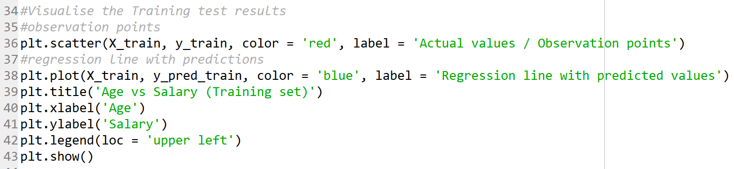
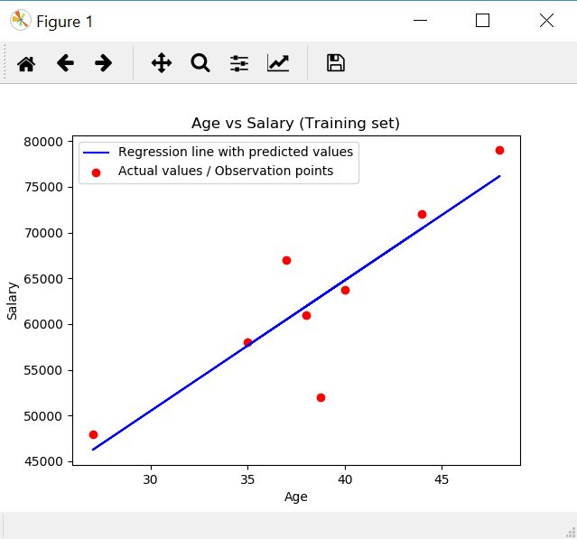
Step 7: Visualise the result on a graph
‘plt’ is the alias for matplotlib.pyplot library that we imported in the beginning
What are we trying to do here?
On a graph, we have plotted the observation points and the simple linear regression line. (Eremenko and de Ponteves, n.d.)
Purpose is to see the linear dependency and how the predictions of this simple linear model can be close to the real observations. (Eremenko and de Ponteves, n.d.)
Similar prediction and visualization could be performed for the test subset as well to see how good is our model is at predicting the outcome.

Slide 10
Bibliography
Pandas.pydata.org. (n.d.). Python Data Analysis Library — pandas: Python Data Analysis Library. [online] Available at: https://pandas.pydata.org/ [Accessed 5 Dec. 2017].
Matplotlib.org. (n.d.). Pyplot tutorial — Matplotlib 2.0.2 documentation. [online] Available at: https://matplotlib.org/users/pyplot_tutorial.html [Accessed 5 Dec. 2017].
Scikit-learn.org. (n.d.). 4.3. Preprocessing data — scikit-learn 0.19.1 documentation. [online] Available at: http://scikit-learn.org/stable/modules/preprocessing.html#preprocessing [Accessed 6 Dec. 2017].
Scikit-learn.org. (n.d.). sklearn.cross_validation.train_test_split — scikit-learn 0.16.1 documentation. [online] Available at: http://scikit-learn.org/0.16/modules/generated/sklearn.cross_validation.train_test_split.html [Accessed 6 Dec. 2017].
Pandas.pydata.org. (n.d.). Indexing and Selecting Data — pandas 0.21.0 documentation. [online] Available at: https://pandas.pydata.org/pandas-docs/stable/indexing.html#indexing-integer [Accessed 6 Dec. 2017].
Scikit-learn.org. (n.d.). 4.3. Preprocessing data — scikit-learn 0.19.1 documentation. [online] Available at: http://scikit-learn.org/stable/modules/preprocessing.html#imputation [Accessed 7 Dec. 2017].
Scikit-learn.org. (n.d.). sklearn.preprocessing.Imputer — scikit-learn 0.19.1 documentation. [online] Available at: http://scikit-learn.org/stable/modules/generated/sklearn.preprocessing.Imputer.html [Accessed 7 Dec. 2017].
scikit-learn, F. (n.d.). Fitting data vs. transforming data in scikit-learn. [online] Stackoverflow.com. Available at: https://stackoverflow.com/questions/31572487/fitting-data-vs-transforming-data-in-scikit-learn [Accessed 7 Dec. 2017].
Towards Data Science. (n.d.). Train/Test Split and Cross Validation in Python – Towards Data Science. [online] Available at: https://towardsdatascience.com/train-test-split-and-cross-validation-in-python-80b61beca4b6 [Accessed 7 Dec. 2017].
set?, W. (n.d.). What is the difference between test set and validation set?. [online] Stats.stackexchange.com. Available at: https://stats.stackexchange.com/questions/19048/what-is-the-difference-between-test-set-and-validation-set [Accessed 7 Dec. 2017].
En.wikipedia.org. (n.d.). Curve fitting. [online] Available at: https://en.wikipedia.org/wiki/Curve_fitting [Accessed 7 Dec. 2017].
quora.com. (n.d.). What does fitting a model mean in data science?. [online] Available at: https://www.quora.com/What-does-fitting-a-model-mean-in-data-science [Accessed 7 Dec. 2017].
En.wikipedia.org. (n.d.). Linear regression. [online] Available at: https://en.wikipedia.org/wiki/Linear_regression [Accessed 7 Dec. 2017].
Eremenko, K. and de Ponteves, H. (n.d.). Simple Linear Regression in Python - Step 4. [video] Available at: https://www.udemy.com/machinelearning/learn/v4/t/lecture/5768342?start=0 [Accessed 7 Dec. 2017].

Slide 11
Thank you for your time!!

